Slide 1
Open Targets Platform: integrating human data for drug discovery
Part of “Introduction to RNA-Seq and Functional Interpretation”
EMBL-EBI
January 23rd 2020
Denise Carvalho-Silva
Asier Gonzalez
Open Targets | EMBL-EBI
Wellcome Genome Campus

Slide 2
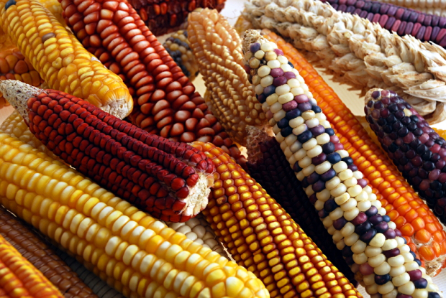
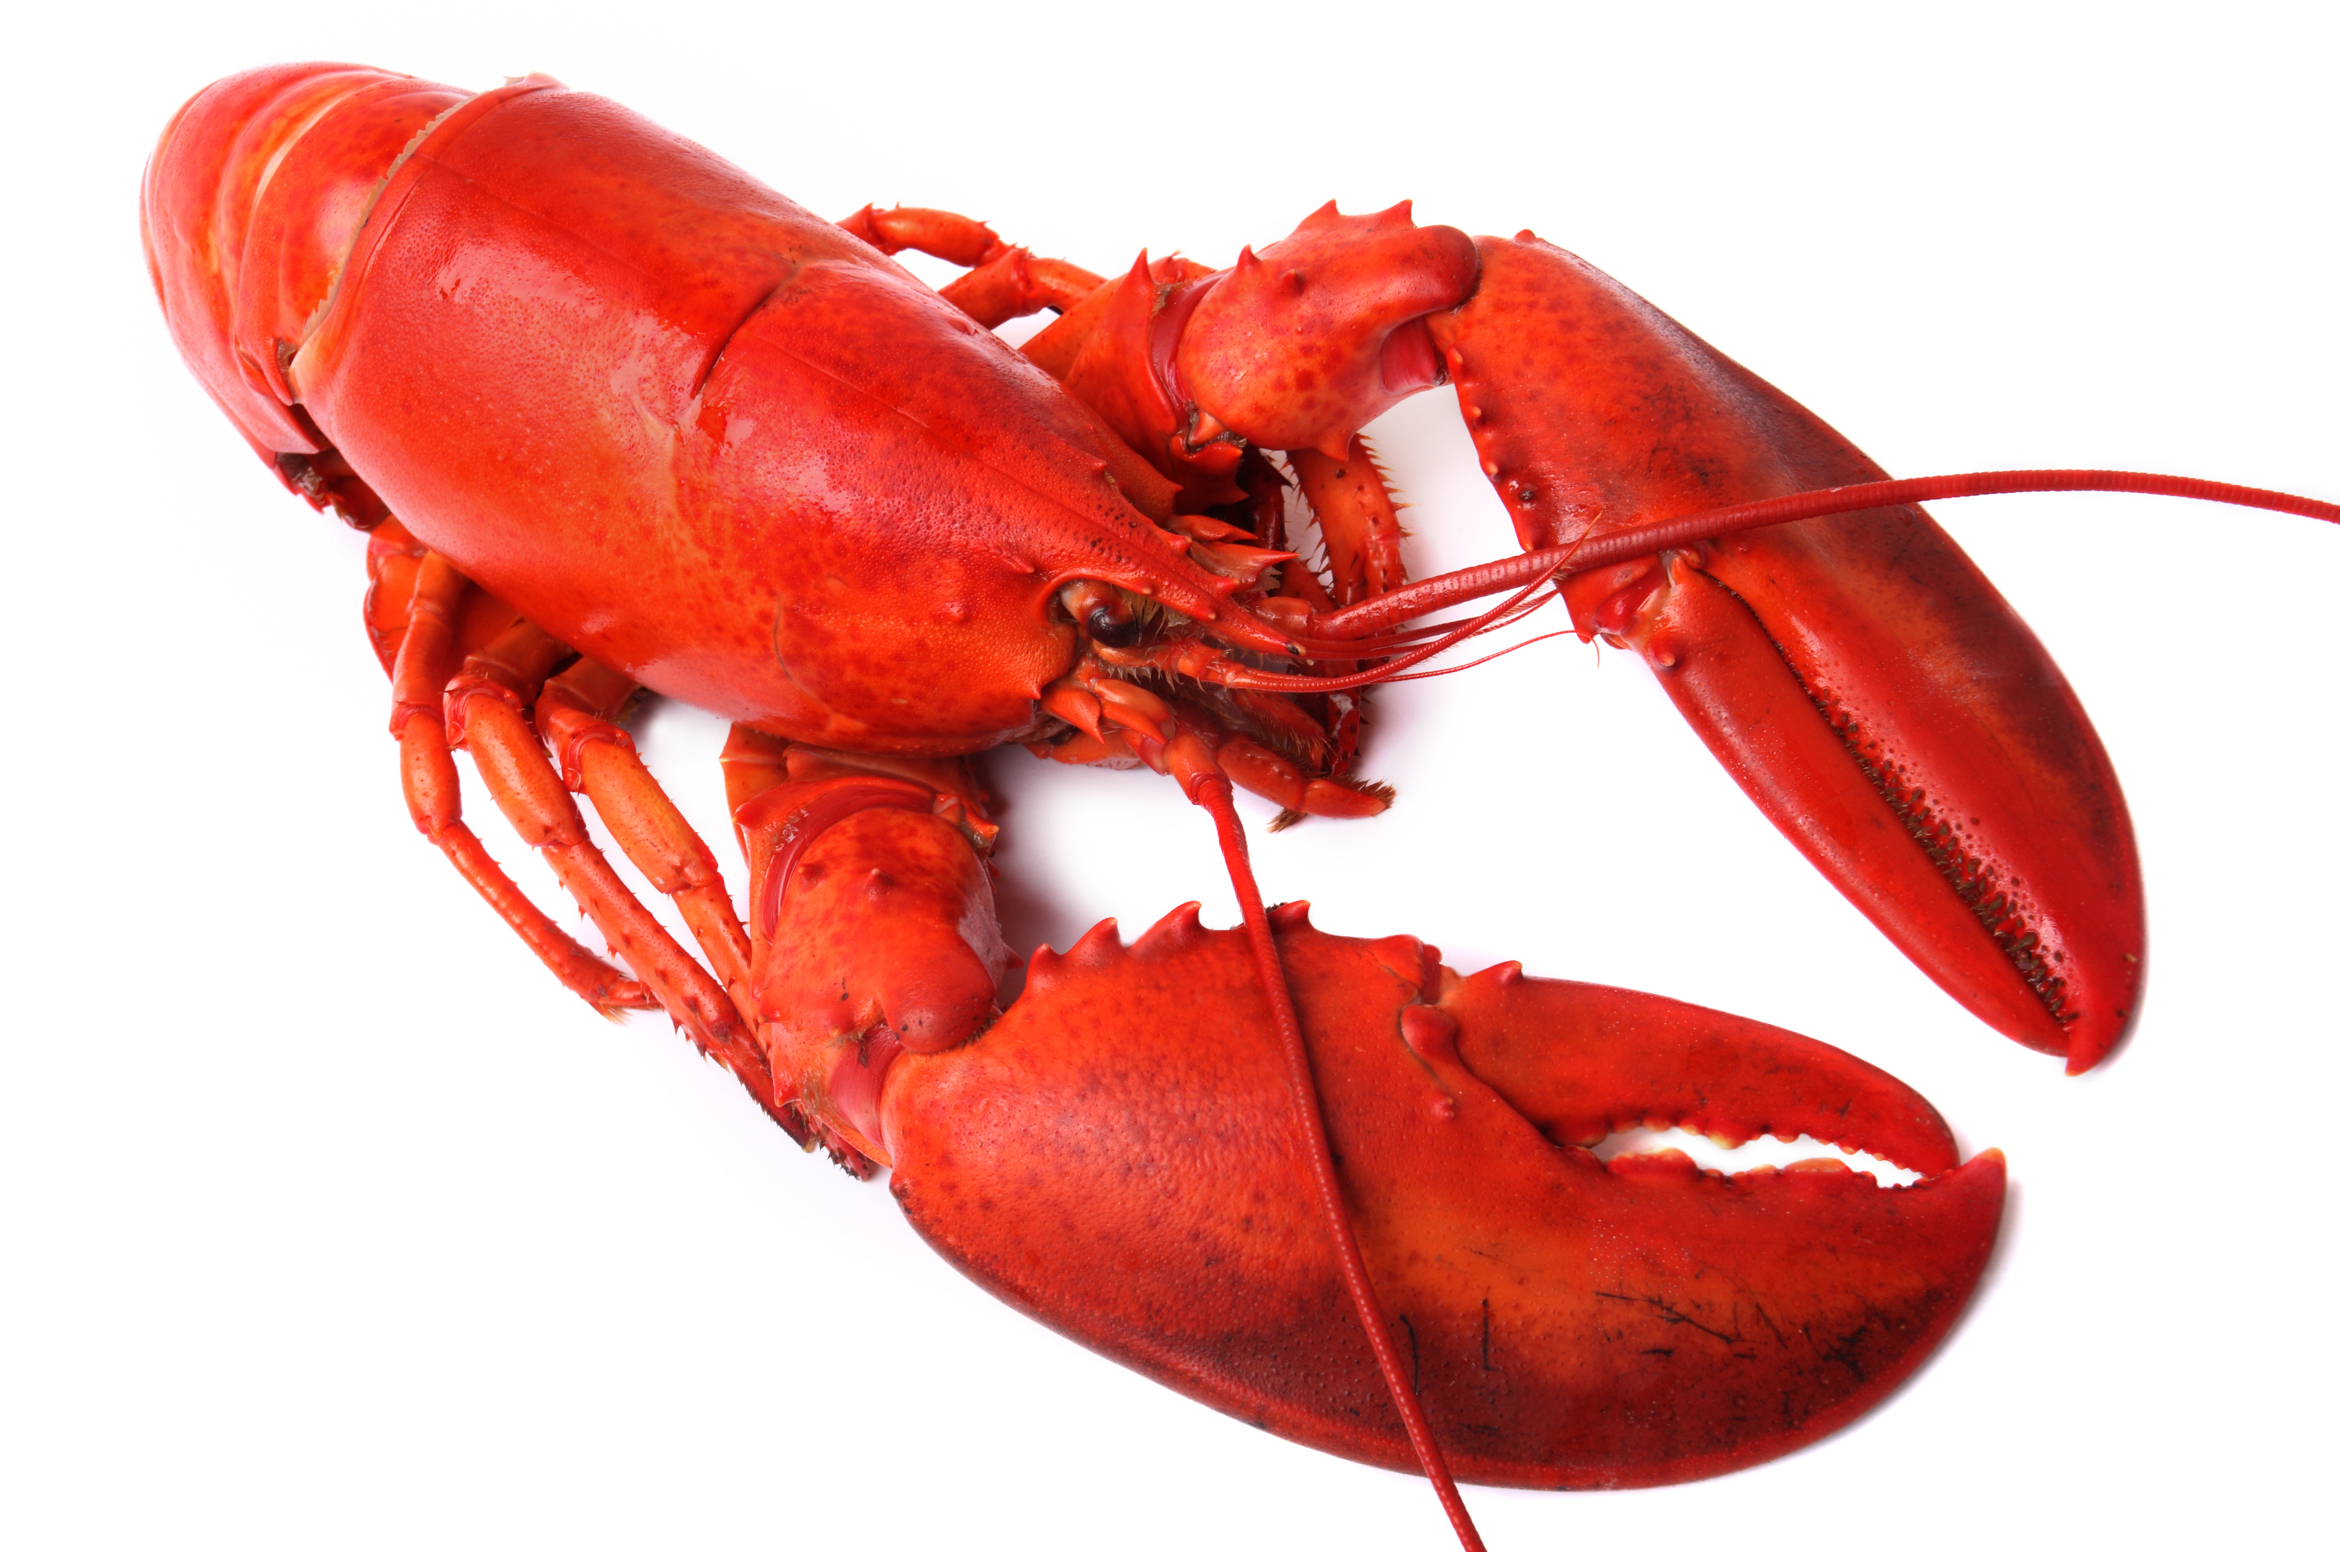

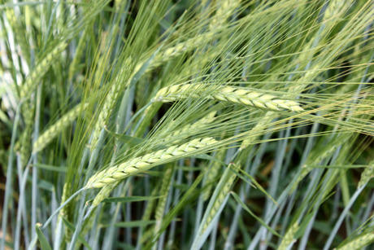
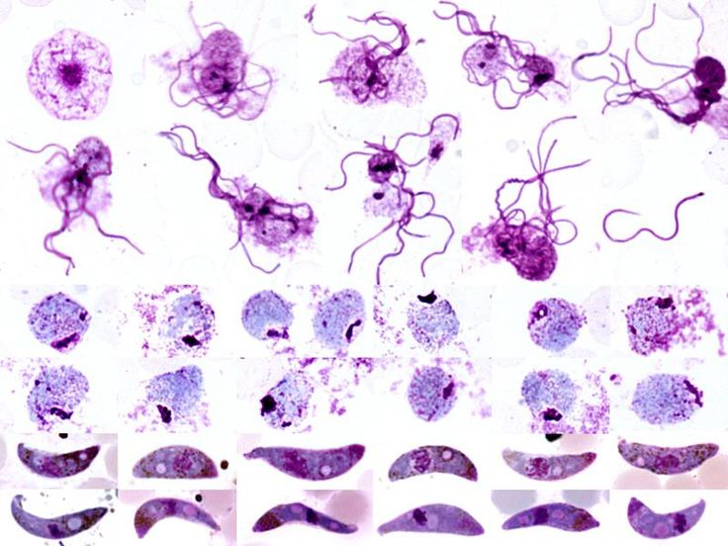





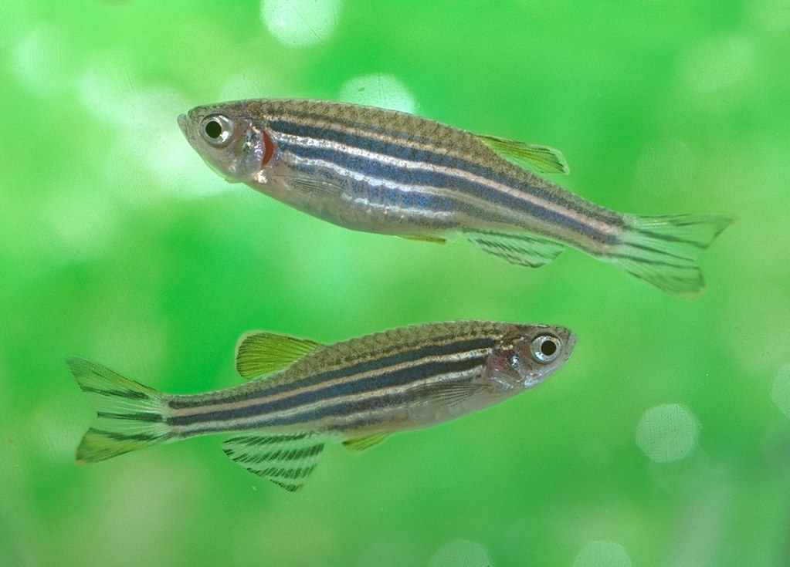


Slide 3

Translational research
and drug discovery

Slide 4
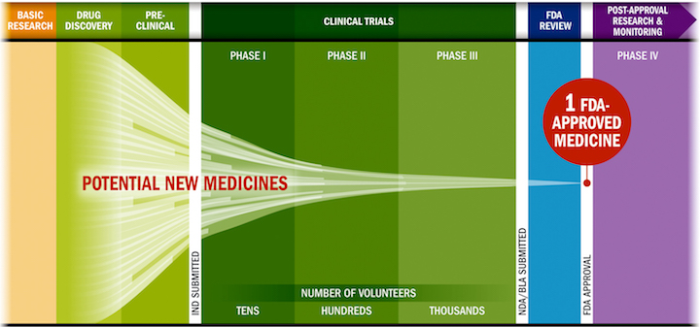
Challenges in drug discovery
Lengthy, costly, low success rate, HIGH ATTRITION RATES
Source: PhRMA adaptation based on Tufts CSDD & School of Medicine, and FDA

Slide 5
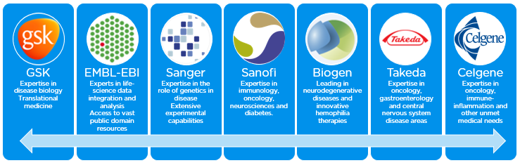
Open Targets
Founding partners
2018
2016
2017
2018
Transform drug discovery
Systematic identification and prioritisation of targets

Slide 6
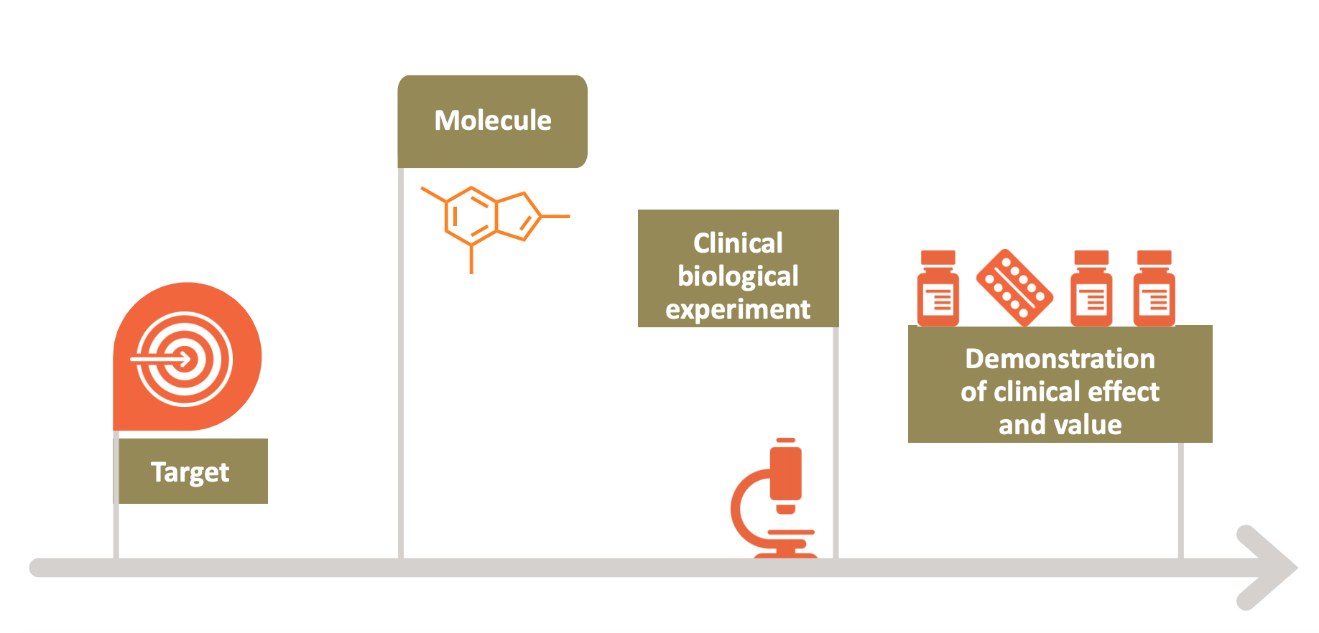
Select the right target: our focus
Drugs that fail are neither safe nor efficacious

Slide 7
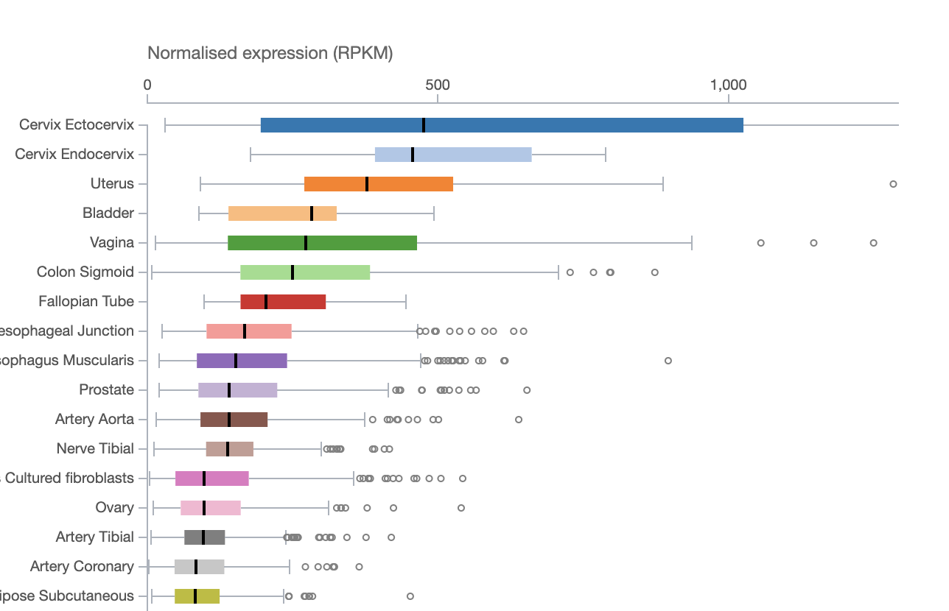
How can transcriptomics help?
Where is my target expressed?

Slide 8
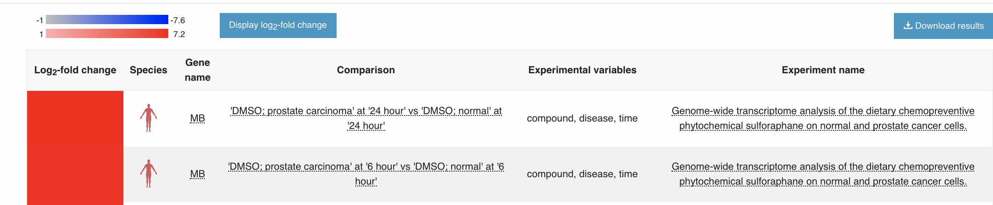
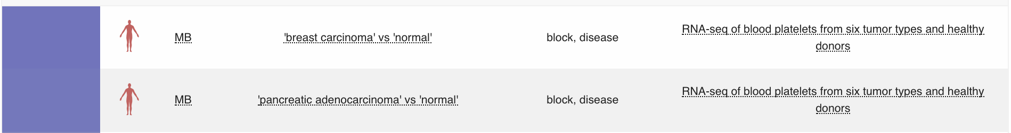
How can transcriptomics help?
2) Is there a difference in expression in disease x normal tissues?

Slide 9
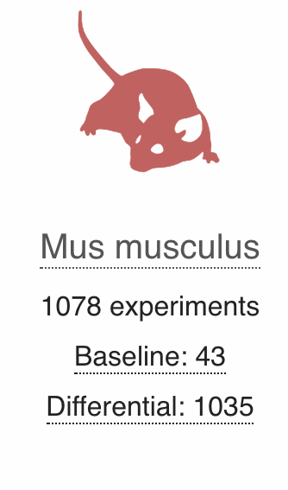
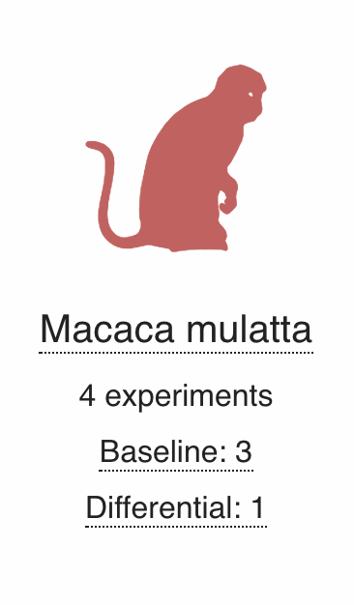
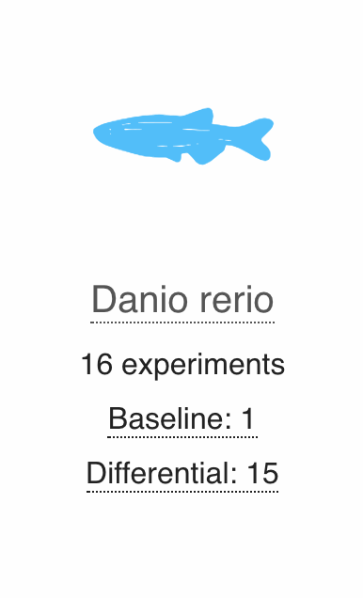
How can transcriptomics help us?
3) Where is the gene expressed in model animals?

Slide 10
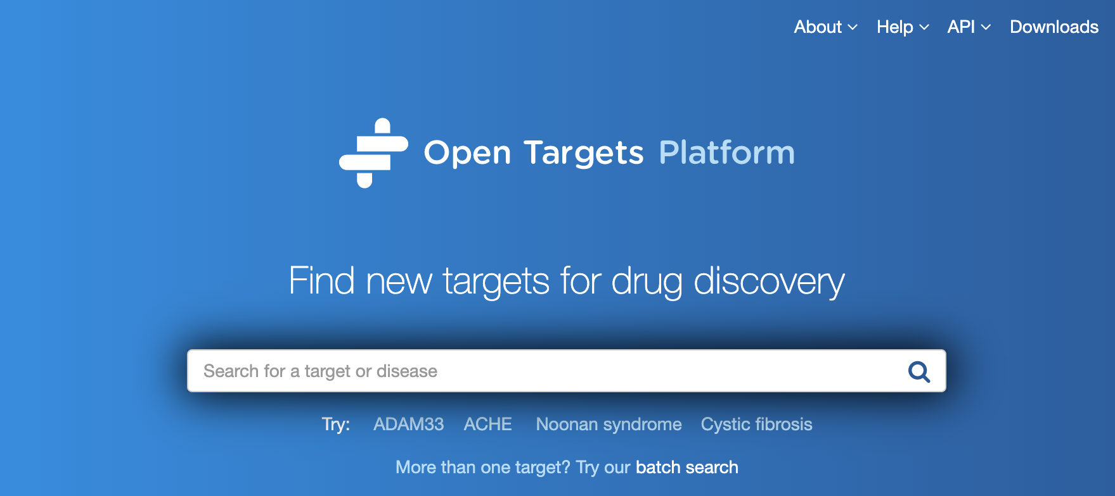
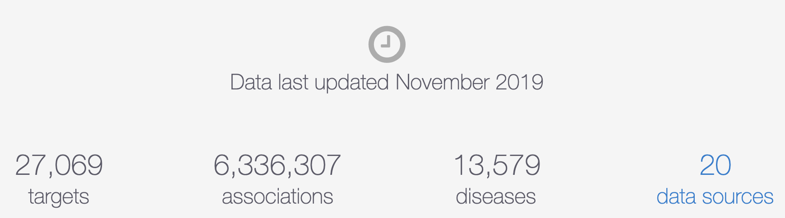

Slide 11
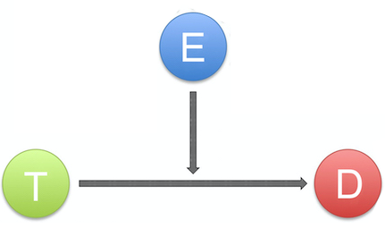
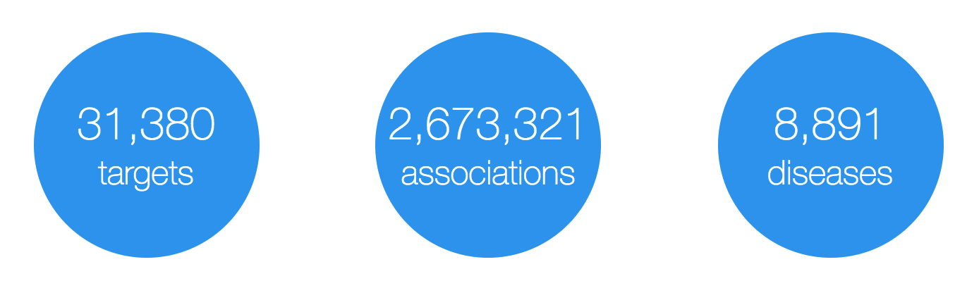
Open Targets Platform: data model
Evidence
(differential RNA expression, etc)
Target
(protein and non-protein coding genes)
Disease
(rare and common)
https://www.targetvalidation.org

Slide 12
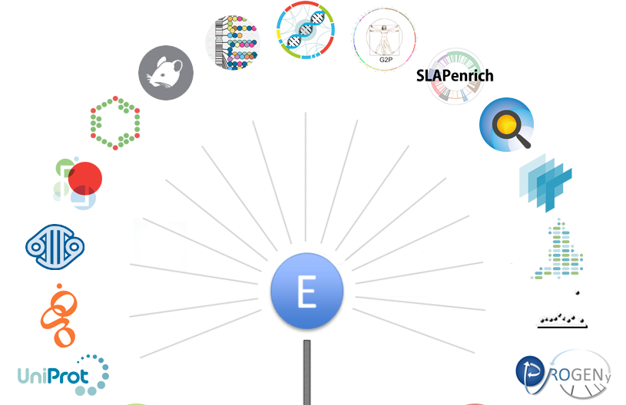
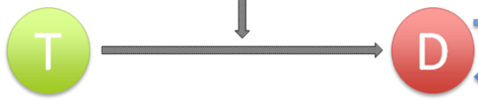
Evidence for target-disease associations
8,919,232
https://docs.targetvalidation.org/data-sources/data-sources

Slide 13
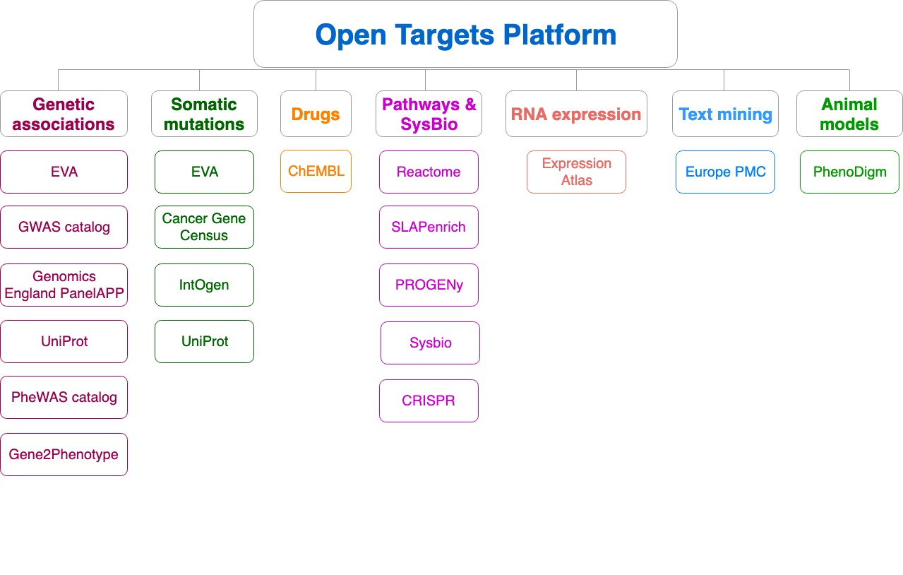
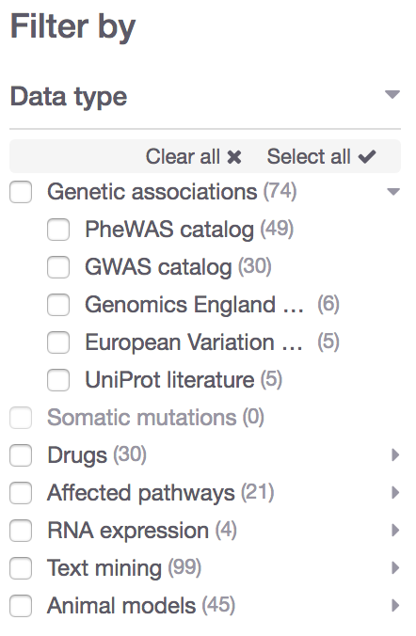
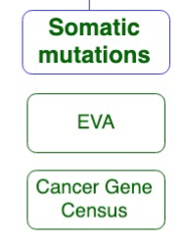
Data sources grouped into data types
Data type
Data source

Slide 14















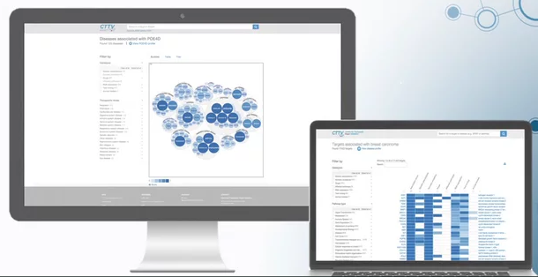

Evidence integration pipeline*
Target Profile Page
JSON
summary
document
Validator
Score
calculation
Disease Profile Page
* e.g. RNAseq and microarray expression data from Expression Atlas

Slide 15
Evidence summary document
* IDs (gene, disease, papers) + source + stats for the score

Slide 16
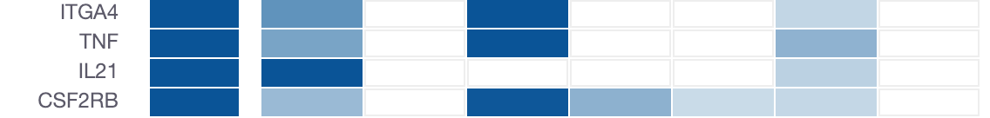
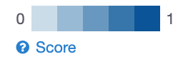
Target-disease association score
Convey confidence
More evidence → stronger association score
Different evidence are scored and weighted in different ways
Overall score
Genetic
Somatic
Drugs
Pathways
Expression
Text mining
Animal mod

Slide 17
Four association scores
Evidence → Overall
Statistical integration, aggregation and scoring
1) Evidence score (e.g. one SNP from a GWAS paper)
2) Data source score (e.g. all SNPs from the GWAS catalog)
3) Data type score (e.g. all sources of Genetic associations)
4) Overall association score
https://docs.targetvalidation.org/getting-started/scoring

Slide 18
Harmonic sum
Σ_{H}
*1.0
Genomics England
Score: 0 to 1 (max)
Σ_{H}
*1.0
PheWAS catalog
Σ_{H}
*1.0
European Variation Archive (germline)
Σ_{H}
*1.0
Σ_{H}
Genetic associations
Calculated at four levels:
Evidence
Data source
Data type
Overall
UniProt
Σ_{H}
*1.0
Gene2Phenotype
Σ_{H}
*1.0
GWAS catalog
Σ_{H}
*1.0
Cancer Gene Census
Σ_{H}
*1.0
European Variation Archive (somatic)
Σ_{H}
Somatic mutations
Σ_{H}
*1.0
IntOGen
Aggregation with (harmonic sum)
Σ_{H}
Σ_{H}
*1.0
ChEMBL
Drugs
Σ_{H}
*1.0
Reactome
Note: Each data set has its own scoring and ranking scheme
Σ_{H}
*0.5
SLAPenrich
Σ_{H}
*0.5
Σ_{H}
Pathways &
systems biology
PROGENy
Σ_{H}
*0.5
Sysbio
Σ_{H}
*0.2
Expression Atlas
RNA expression
Σ_{H}
*0.2
Europe PMC
Text mining
Σ_{H}
*0.2
PhenoDigm
Animal models
weight factor
Σ_{H}
S₁ + S₂/2² + S₃/3² + S₄/4² + S_{i}/i²
Σ_{H}
Association

Slide 19

Computing the evidence score
score = f * s * c
f, relative occurrence of a target-disease evidence
s, strength of the effect of the variant
c, confidence of the observation for the target-disease evidence
f = sample size (cases and controls)
s = predicted functional consequence (VEP)
c = p value reported in the paper
(Factors affecting the relative strength of GWAS Catalog evidence)

Slide 20
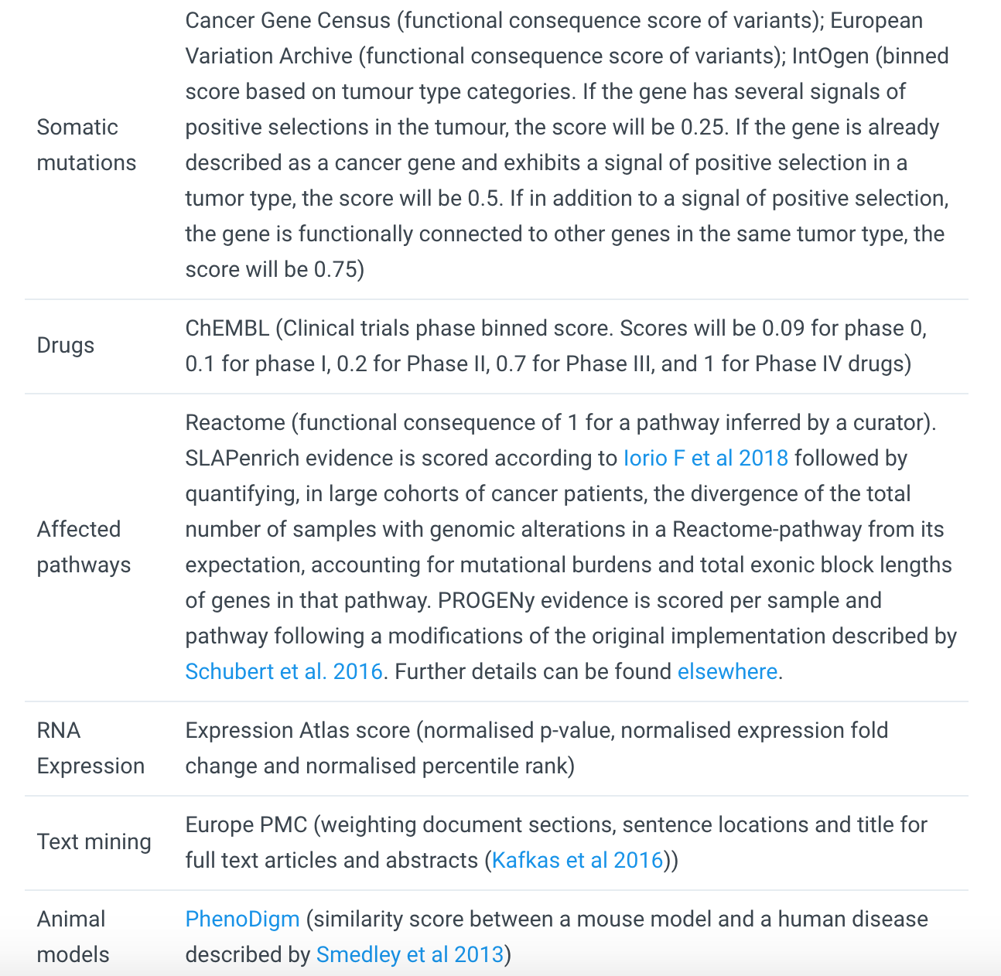
https://docs.targetvalidation.org/getting-started/scoring
Factors affecting the relative strength of the evidence

Slide 21

What can you do with the Open Targets Platform?
Target-disease associations (+ evidence + score)
https://www.targetvalidation.org/evidence/ENSG00000141510/EFO_0000228
Target annotations
http://www.targetvalidation.org/target/ENSG00000141510
Disease annotations
http://www.targetvalidation.org/diseaset/EFO_0000228

Slide 22
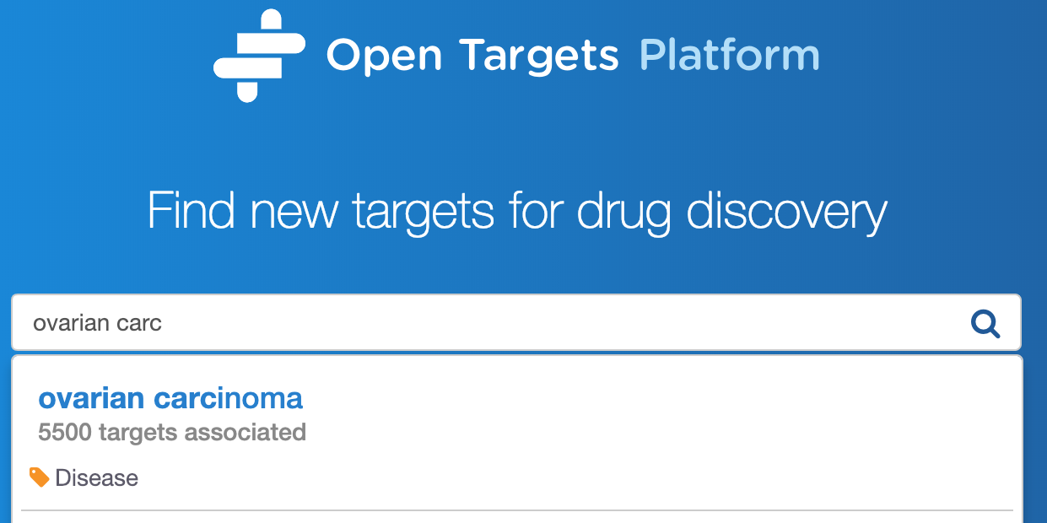
Live demo 1
Which targets are associated with my disease?
What is the evidence for the association?
Is there any data to help to prioritise the list of associated targets?
Coursebook: pages 8-16

Slide 24
What can you do with the Open Targets Platform?
Target-disease associations (+ evidence + score)
https://www.targetvalidation.org/evidence/ENSG00000141510/EFO_0000228
Target annotations
https://www.targetvalidation.org/target/ENSG00000141510
Disease annotations
https://www.targetvalidation.org/diseaset/EFO_0000228

Slide 25
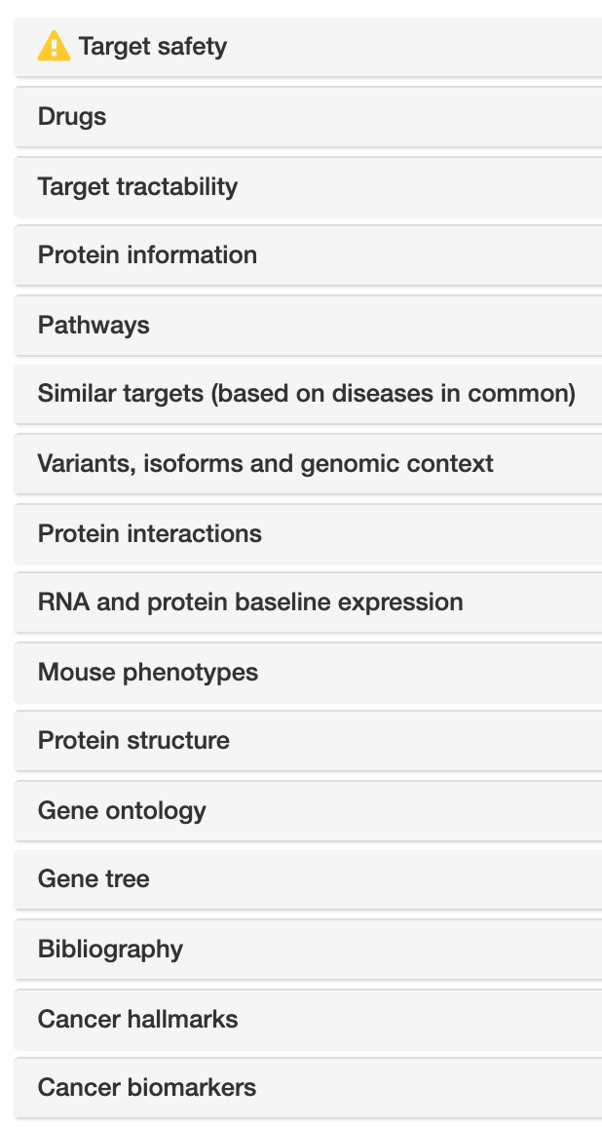
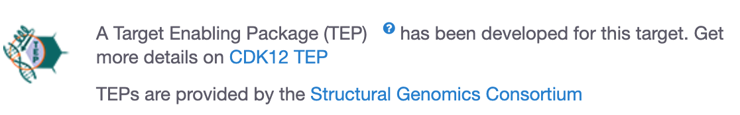
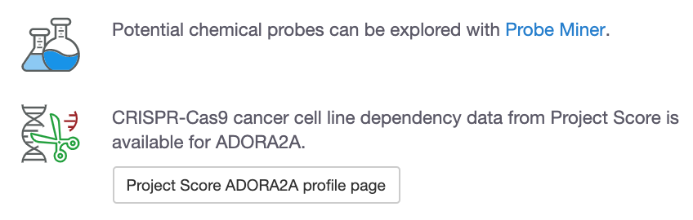
Target annotations
Target
profile page

Slide 26
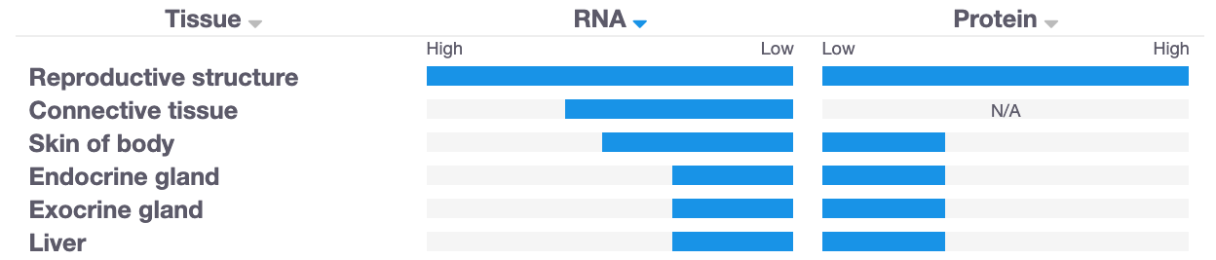
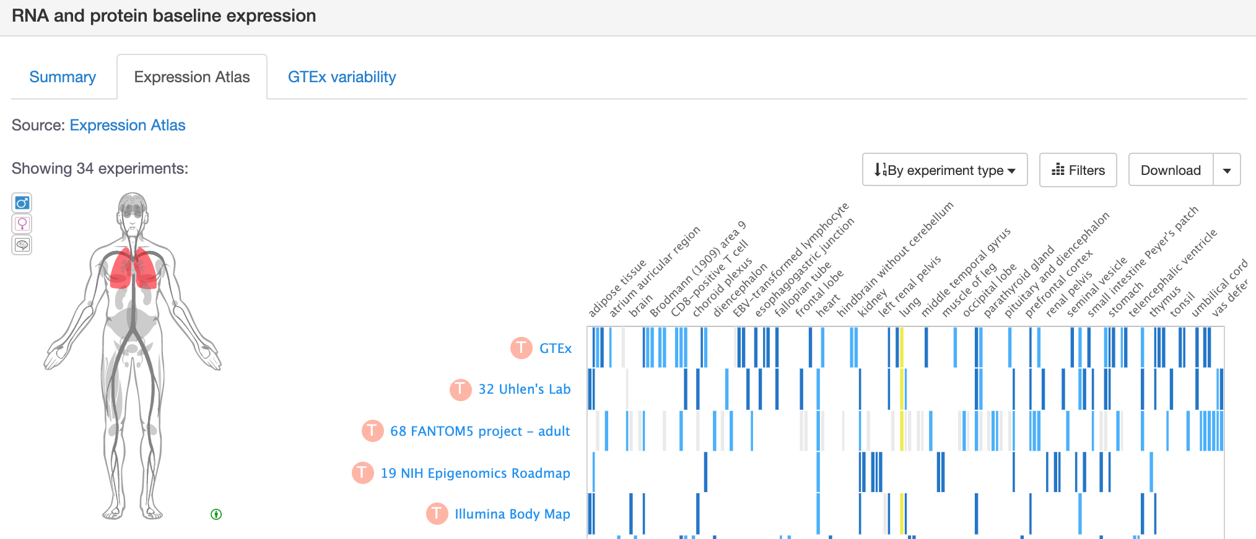
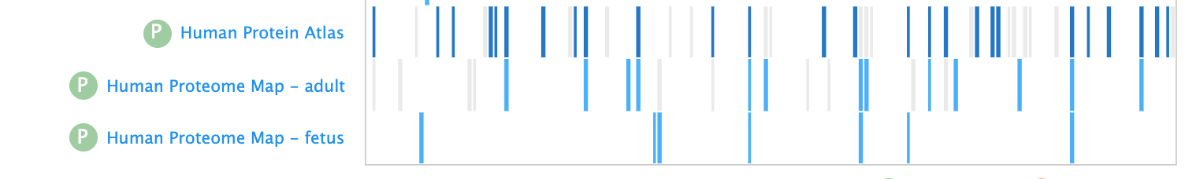
Is my target expressed in the relevant tissue?

Slide 27
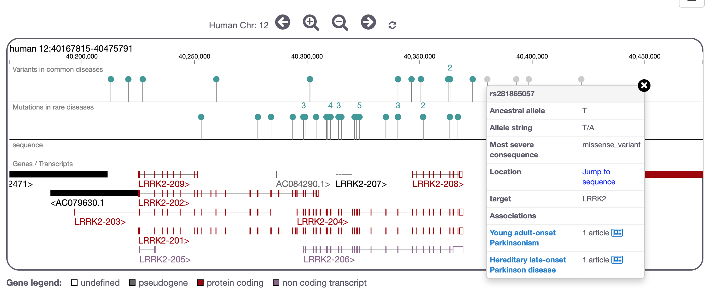
Does my target have disease-associated variants?

Slide 28
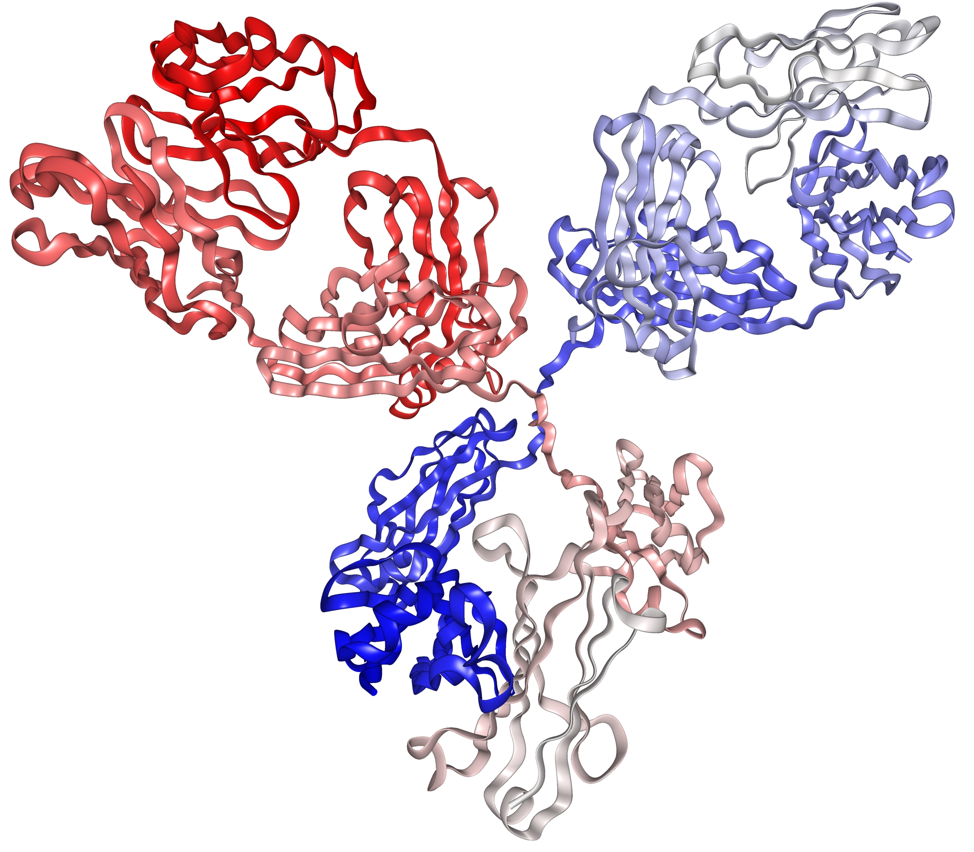
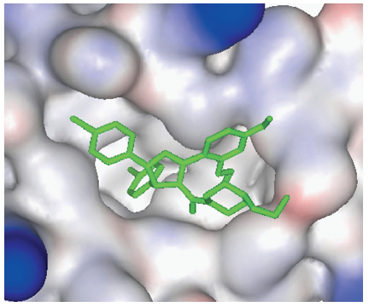
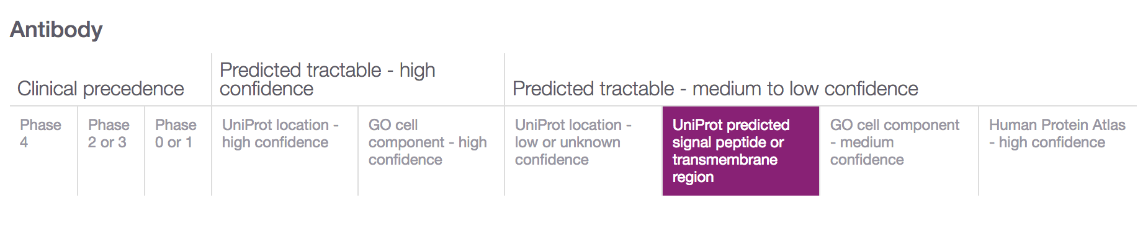
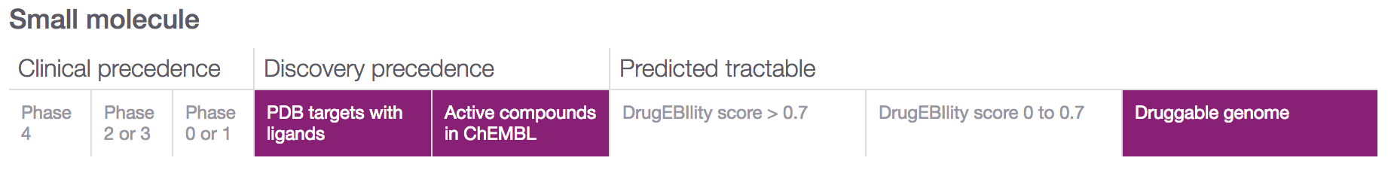
Is my target tractable?
DOI:10.1517/17460441.3.4.391
https://www.immunology.org/structure-antibody-1972

Slide 29
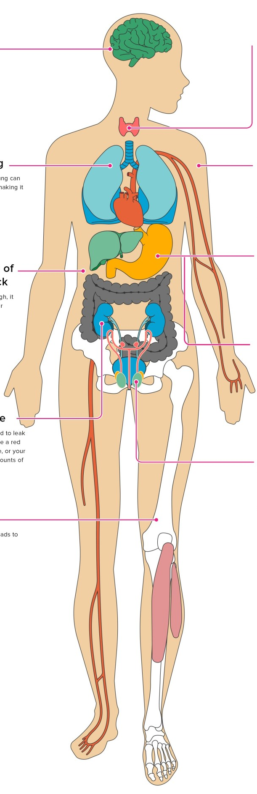
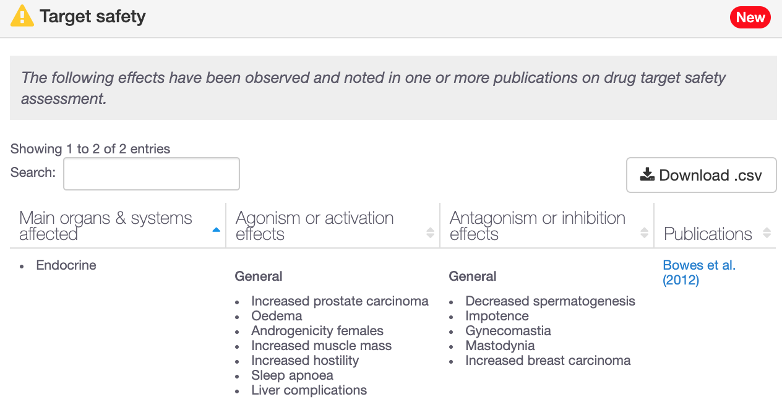
Is my target safe to be modulated?
193 genes with target safety information
Drowsiness
Increased heart rate
Hepatotoxicity

Slide 30
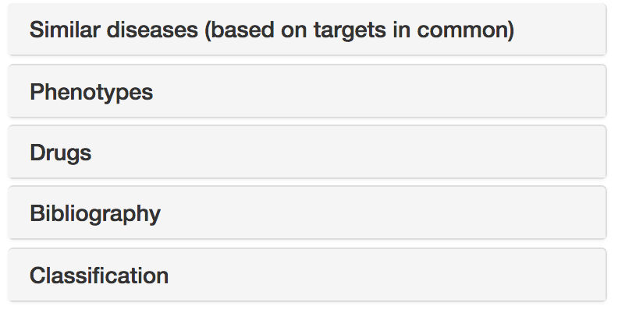




Disease annotations
Disease profile page
https://docs.targetvalidation.org/getting-started/getting-started/disease-profile

Slide 31
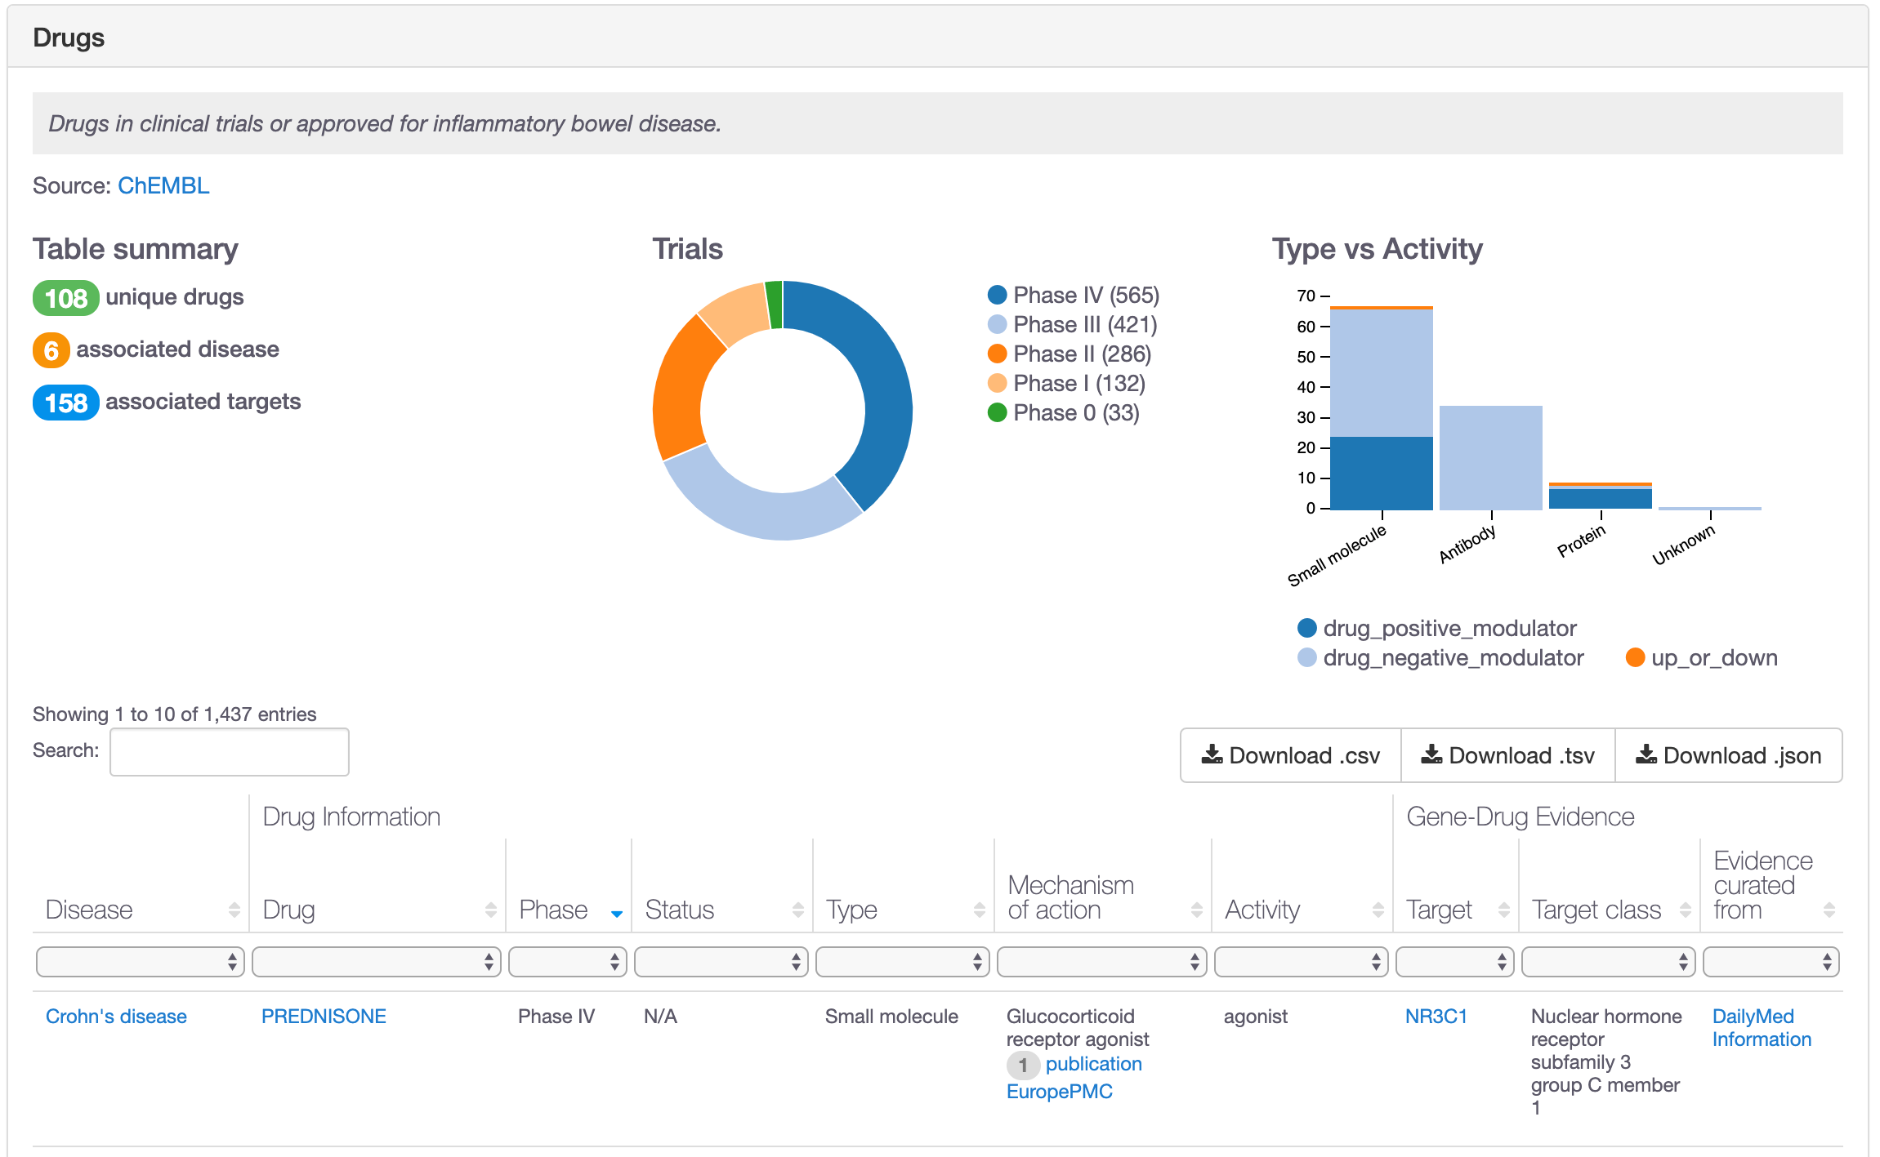
Which drugs are in clinical trials?

Slide 32
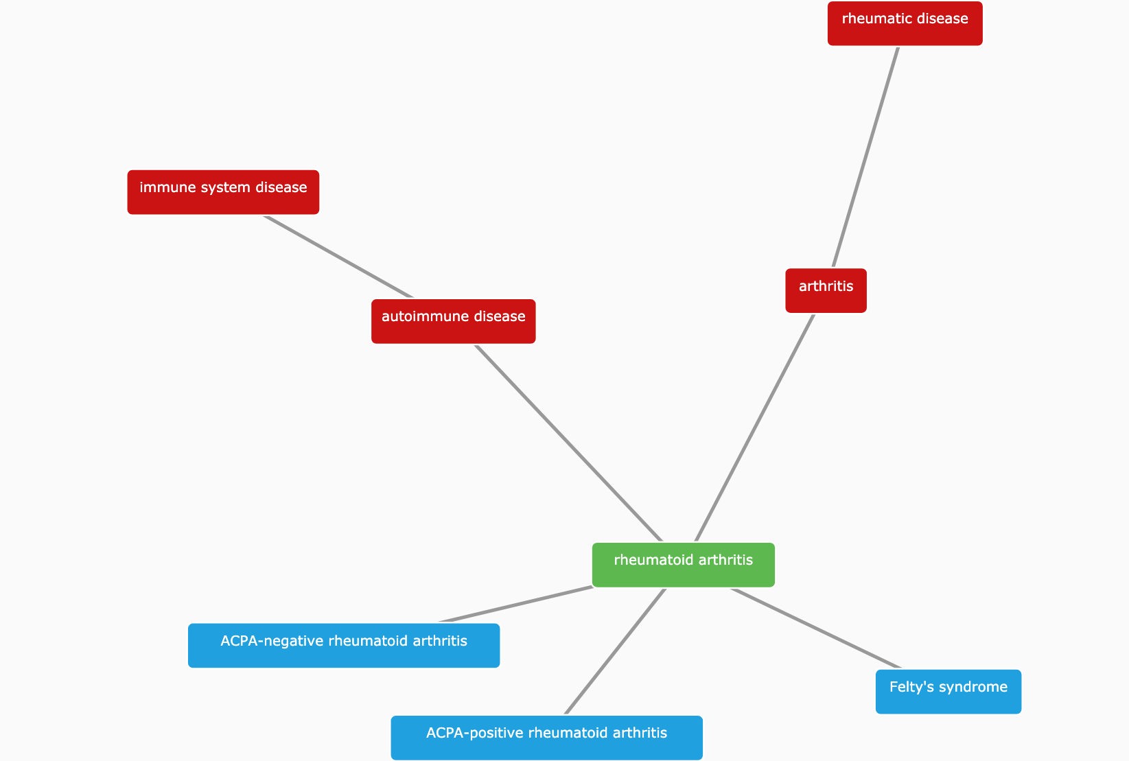
What is the relationship with other diseases?
https://www.targetvalidation.org/disease/EFO_0000685

Slide 33
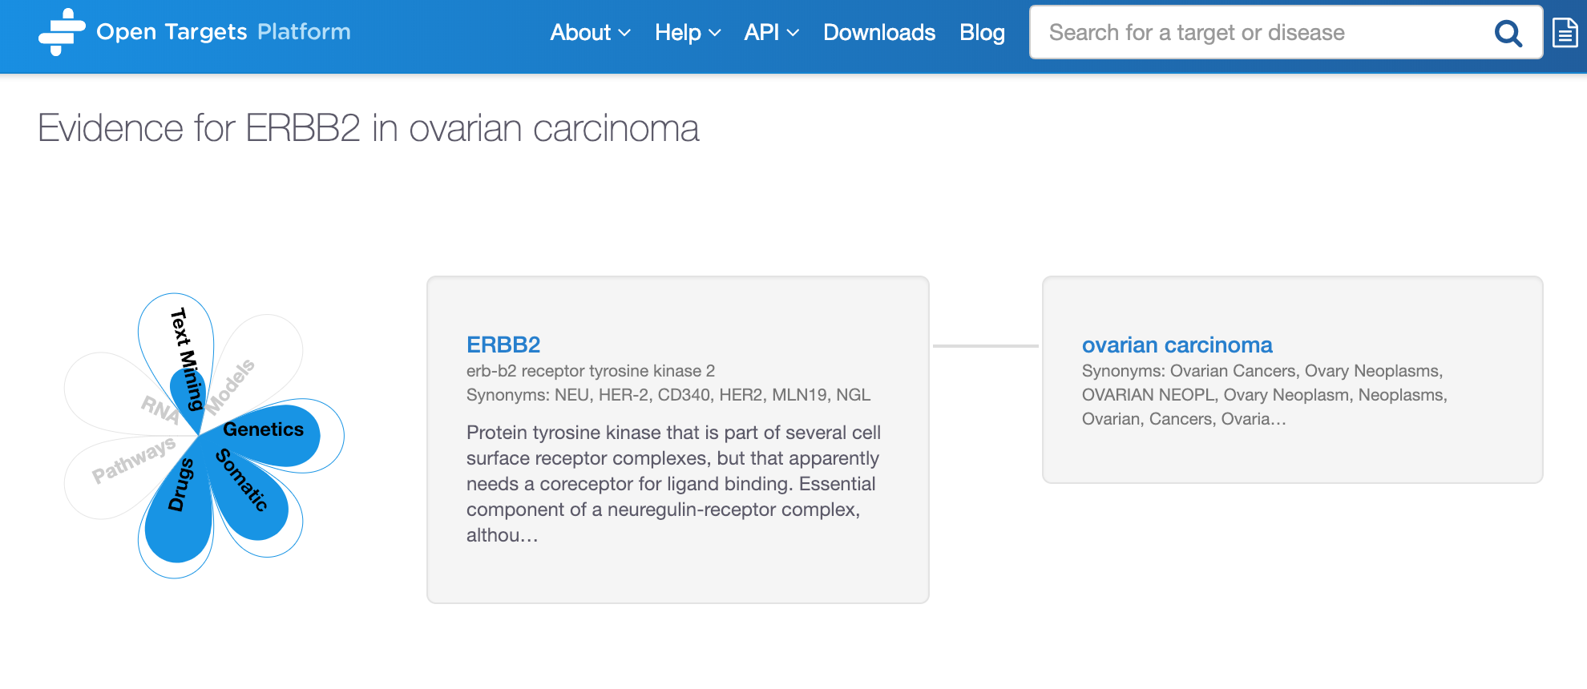
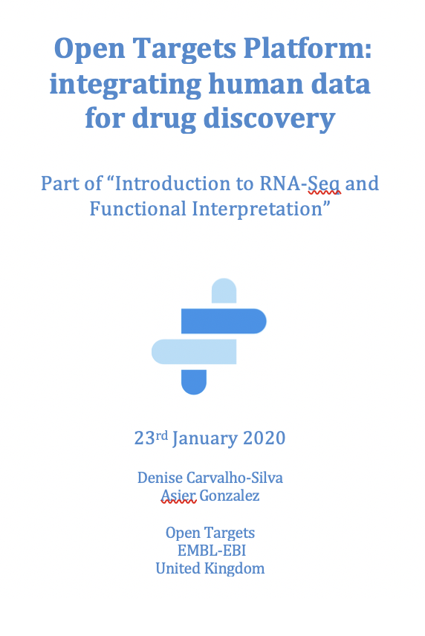
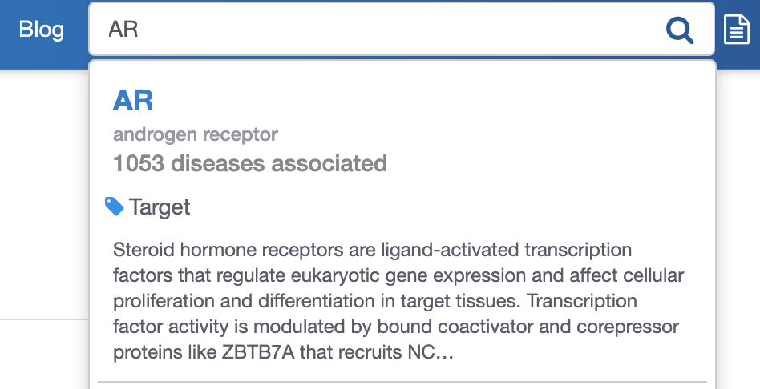
Hands-on activities
Target
profile page
Disease profile page
Target centric search
Exercises
Pages 28-33
Demo
Pages 16-27

Slide 34
One target at a time only

Slide 35
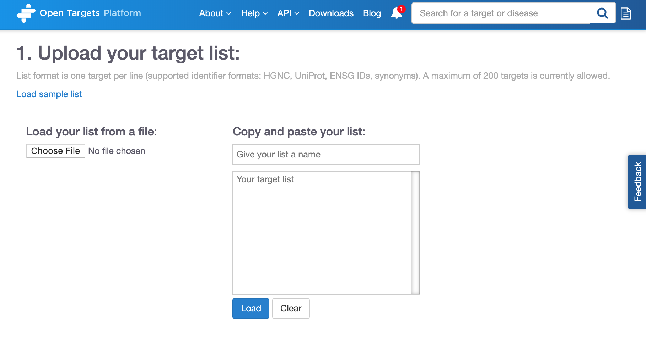
Batch search
https://www.targetvalidation.org/batch-search

Slide 36
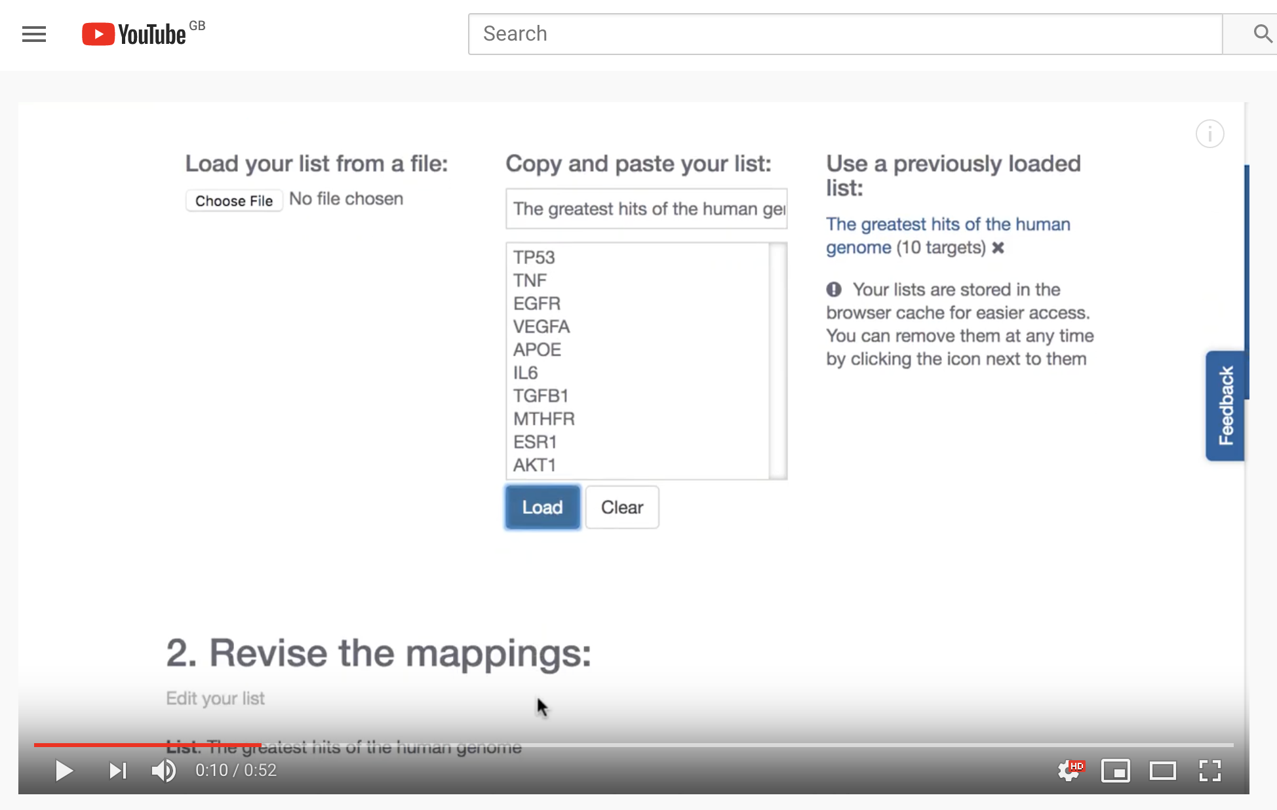
Batch search tool on YouTube
https://www.youtube.com/watch?v=CPkAxnVrt_s

Slide 37
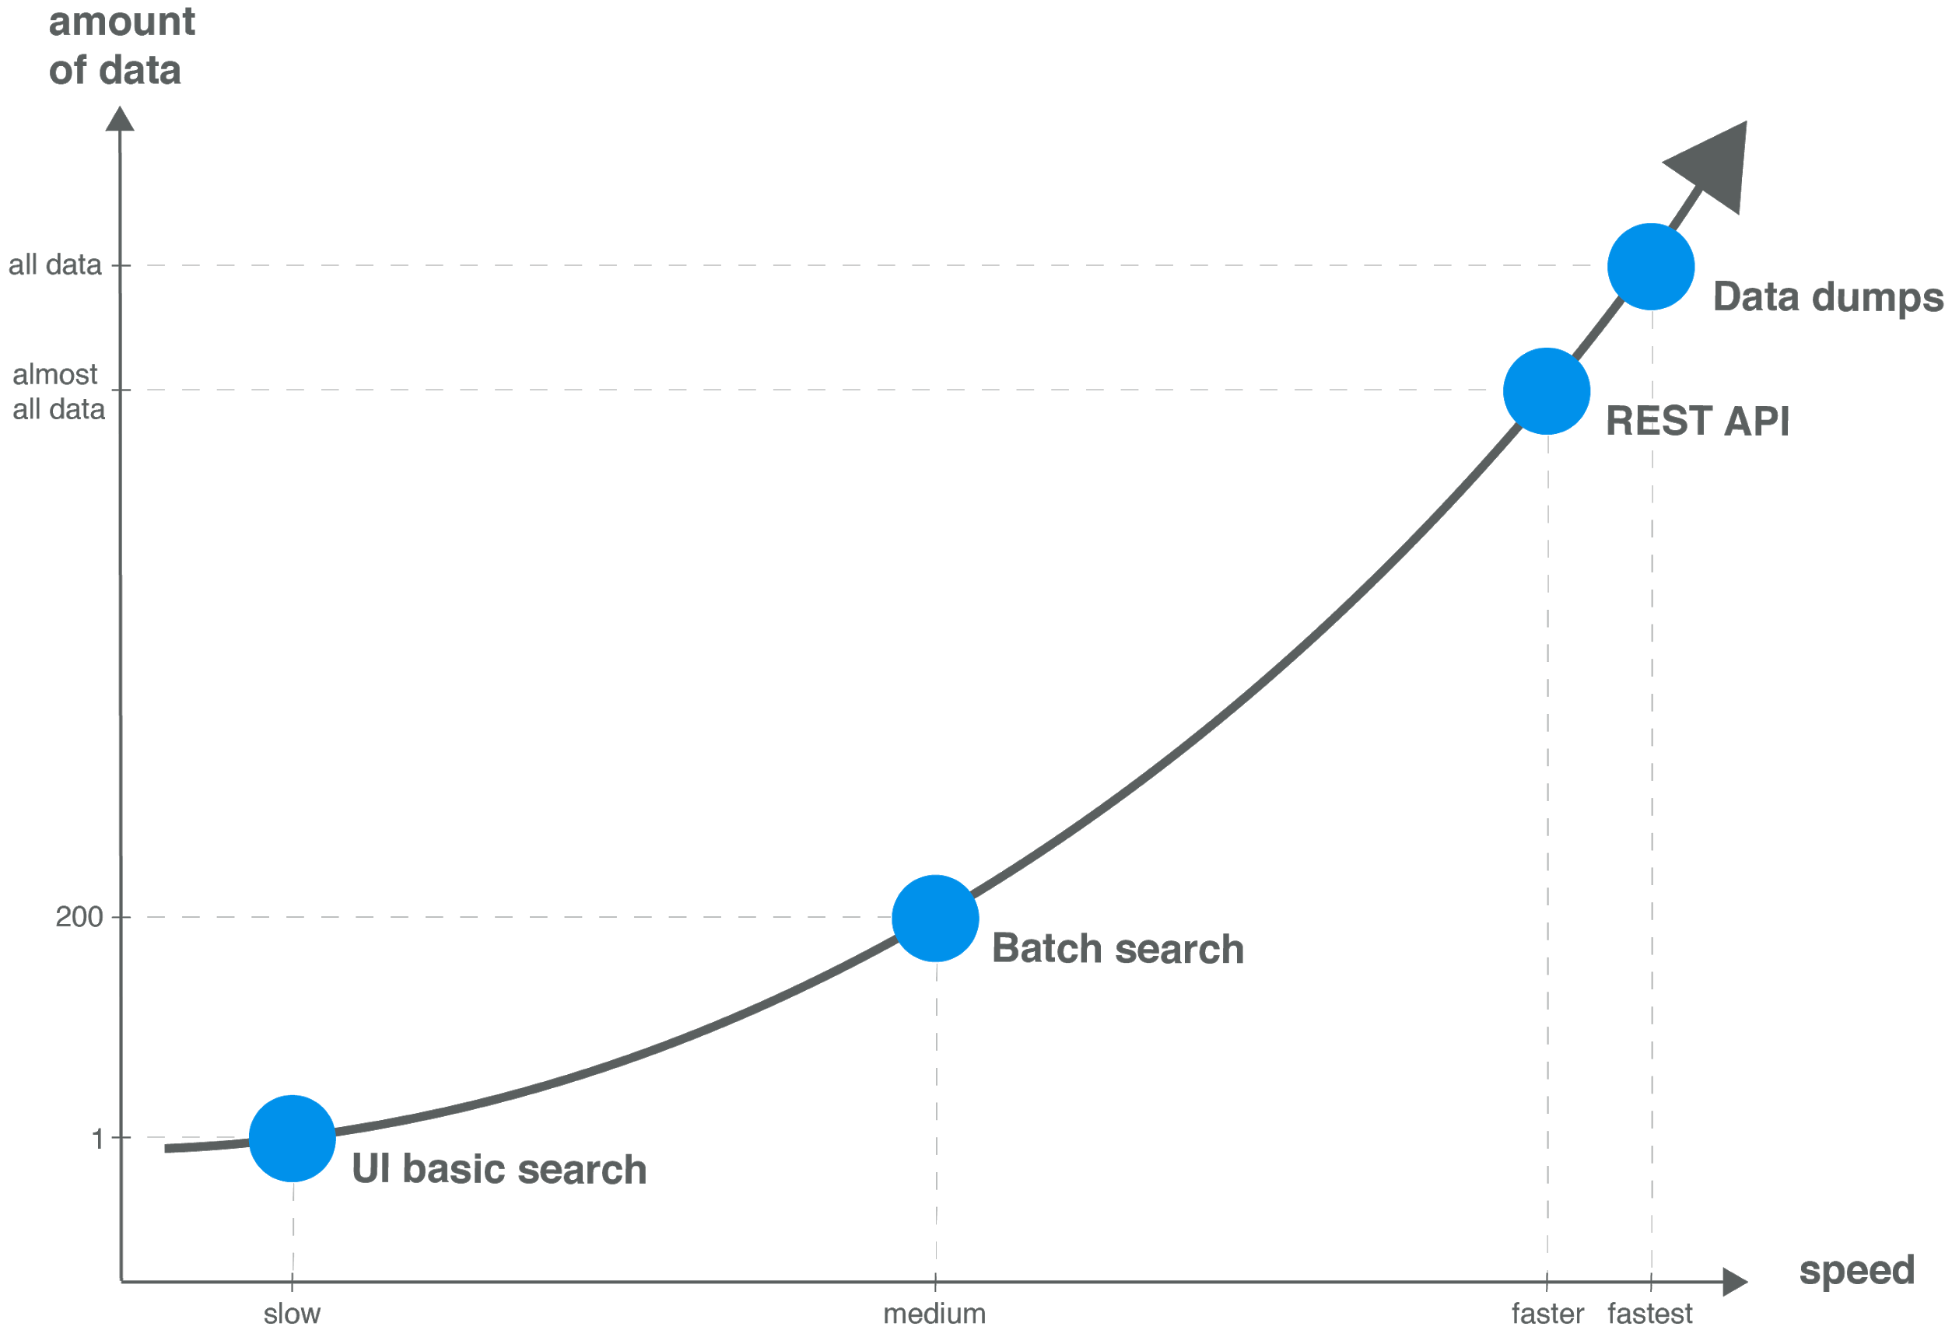
Modes of access → data volume

Slide 38




Open Targets Platform REST API*
Server
https://platform-api.opentargets.io/v3/platform/
Endpoint
public/association/filter
Parameters
?target=ENSG00000163914&size=10000&fields=target.id&fields=disease.id
Open Targets Python client **
*
https://docs.targetvalidation.org/tutorials/rest-api
**
https://docs.targetvalidation.org/tutorials/python-client

Slide 39


Looking for the entire data?

Slide 40
Wrapping up
Founding partners
2018
2016
2017
2018
Transform drug discovery
Systematic identification and prioritisation of targets

Slide 41









Knowledge cycle
Public data
Experimental projects
Bioinformatics projects
DATA
GENERATION
DATA
INTEGRATION
Therapeutic hypothesis

Slide 42
Open Targets Platform
Resource of integrated multiomics data
Added value (e.g. score) and links to original sources
Graphical web interface: easy to use
Drug discovery, translational medicine, disease biology
Oh Yes!
And all is 100% free
27K
targets
13.5K
diseases
6.3 M
associations
8.9 M
evidence
November 2019 release

Slide 43






Data integration: web resources
Data integration: Open Targets
https://www.opentargets.org/resources/#open-targets-platform

Slide 44


One real use case

Slide 45


How can transcriptomics help us?
4) Functional interpretation of variants → gene expression
https://genetics.opentargets.org/variant/1_154453788_C_T

Slide 46
Knowledge cycle
Public data
Experimental projects
Bioinformatics projects
DATA
GENERATION
DATA
INTEGRATION
Therapeutic hypothesis

Slide 47







Data generation: therapeutic areas
5 ongoing projects
7 ongoing projects
9 ongoing projects
3 complete projects
2 complete projects
2 publications
2 publications

Slide 48


Behan et al (2019)
Data now available in the Open Targets Platform e.g.
https://www.targetvalidation.org/evidence/ENSG00000100941/EFO_0000305?view=sec:affected_pathway
WRN sustains in vivo growth in:
colorectal
ovarian
endometrial
gastric
New candidate target for tumourss with MSI (WRN antagonists)

Slide 49








Thank you!
support@targetvalidation.org

Slide 50


Want to learn more?
http://bit.ly/cite-us

Slide 51

Looking for a career move?
https://www.opentargets.org/jobs

